Slide 1
HOME FROM HOME
Jo Hasnip
www.writtle.ac.uk

Slide 2
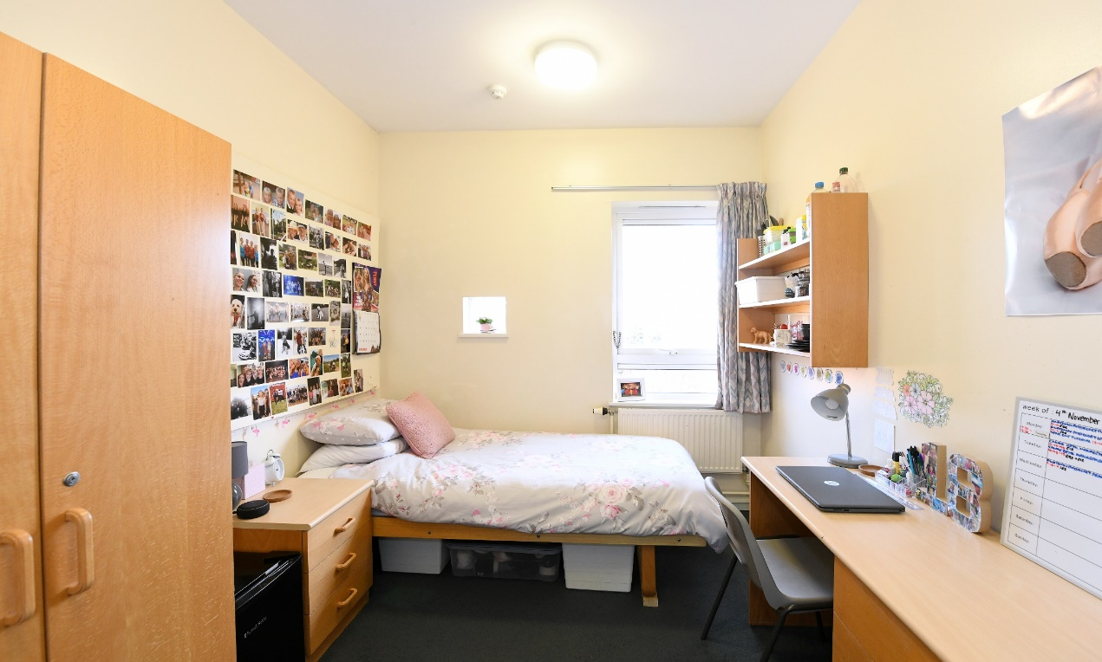
Introduction
14 Halls of residence on campus
Fantastic community atmosphere
Easy access for study and socialising

Slide 3
www.writtle.ac.uk

Slide 4
What's Provided?
Bedroom – with wardrobe, bed (some double), desk and chair, shelving, notice board, curtains, carpets.
Cleaning services of communal areas
Utilities
Common Room/Snack kitchen – with toaster, hob, microwave & combi microwave, kettle, fridge.
Free internet Access
Meals – term time, excluding Christmas and Easter
Free safe for valuables in each room
Onsite car parking

Slide 5
Our Halls of Residence
Gill
Single
Strutt
Single
Double
Harvey
Single with basin
Madison
Single with wet room
Tabor
1 & 3 Single Ensuite
Double Ensuite
Hamilton
Double Ensuite

Slide 6
Why is it beneficial to stay on campus?
Close to lectures
Close to facilities
Eating outlets
Gym
HE Hub
Library
Independent living
Meals are provided in accommodation price*
Meet friends on different courses
Great for socials!
*Equivalent to 2 meals 5 days a week each semester.

Slide 7
What to Bring
Duvet, pillows and your favourite covers! (these can be provided)
Utensils
Plates & Bowls
Cutlery
Pots & Pans
Clothes
Toiletries
Cleaning Products
Stationary
Snacks!

Slide 8
Top Tips
Keep your communal areas clean
Get to know your neighbours at Moving in day
Make the most of Fresher's Week
Get to know the Warden Team and RSSO’s

Slide 9
Prices
Types of Room | Halls Fees*
Large Single Ensuite Hamilton/Tabor 2 (Double Bed) | £6,216
Standard Single Ensuite Maddison/ Tabor 1 & 3 | £5,832
Standard Single with Basin Harvey | £5,210
Large Single no Basin Strutt (Double Bed) | £5,210
Standard Single no basin Gill/Strutt (small) | £4,294
*Fees include meal allowance, utilities, cleaning provision, internet and safe

Slide 10
For More Information…
Speak to the Accommodation Office today
Email: accommdation@writtle.ac.uk

